Slide 1
Sensitivity analyses in meta-analytic reviews
Sven Kepes & Michael A. McDaniel
April 29, 2017

Slide 2
Outline
Meta-analysis and cumulative knowledge
Sensitivity analysis
Sensitivity analysis: Outliers
Sensitivity analysis: Publication bias
Method: Sensitivity analysis
Syntax and results
Results (original data; incl. outliers)
Results (data excl. outliers)
Results table (for your journal article)

Slide 3
Meta-analysis and cumulative knowledge
Meta-analysis is the primary way of generating cumulative knowledge.
Misleading meta-analytic results are problematic because they:
distort current scientific knowledge;
inhibit future scientific progress;
widen the research-practice gap.

Slide 4
Sensitivity analysis
Sensitivity analyses address the question (Greenhouse & Iyengar, 2009, p. 481):
“What happens if aspects of the data or analyses are changed?”
The vast majority of meta-analytic studies do not conduct any type of sensitivity analysis (Aguinis et al., 2011; Kepes et al., 2013).

Slide 5
Sensitivity analysis
In meta-analytic reviews, sensitivity analyses should be conducted to investigate the impact of coded variables not hypothesized to be influential (e.g., language of journal or validation design) as well as characteristics of the data (e.g., outliers and missing data).

Slide 6
Sensitivity analysis: Outliers
Outliers are observations that “deviate markedly from other members of the sample in which it occurs” (Grubbs, 1969, p. 1)
They are quite common in any type of dataset.
Outliers tend to inflate the amount of residual heterogeneity, typically leading to upwardly biased mean estimates (Viechtbauer & Cheung, 2010).
Only around 3% of meta-analytic studies conduct outlier analyses (Aguinis et al., 2011).

Slide 7
Sensitivity analysis: Publication bias
Publication bias (PB) occurs to the extent that research findings on a particular relation that are available are not representative of all research findings on that relation of interest (Kepes et al., 2012).
PB is quite common in our published research (Ferguson & Brannick, 2012).
PB tends to lead to inflated mean estimates (Kepes et al., 2012).
Only around 4% of meta-analytic studies conduct PB analyses (Banks et al., 2012).

Slide 8
Method: Sensitivity analysis
Naïve random-effects (RE) meta-analysis.
Publication bias analyses (Kepes et al., 2012):
Trim and fill (Duval, 2005).
Contour-enhanced funnel plot (Peters et al., 2008).
A priory selection models (Vevea & Woods, 2005).
Cumulative meta-analysis by precision (Kepes et al., 2012).
PET-PEESE (precision-effect test, precision effect estimate with standard error; Stanley and Doucouliagos, 2014).
Tests of excess significance (P-TES; Francis, 2014; Ioannidis & Trikalinos, 2007).

Slide 9
Method: Sensitivity analysis
Outlier analyses:
One-sample removed analysis (aka “leave one out” [LOO] analysis; Borenstein et al., 2009).
Viechtbauer and Cheung’s (2010; see also Viechtbauer, 2015) multifaceted, multivariate outlier detection battery.

Slide 10
Syntax and results
Meta-analysis of brain volume and intelligence:
### Read in data from an Excel file (data are from McDaniel, 2005).
BigBrain <- read_excel("Illustrative data.xls", sheet = "r", col_names = TRUE, col_types = NULL, na = "", skip = 0)
### Look at the data
str(BigBrain)
nrow(BigBrain)
ncol(BigBrain)
### Look at the top 6 cases
head(BigBrain)

Slide 11
Syntax and results
### Run the random effects meta-analysis without any "adjustments" (i.e., the naive meta-analysis)
### meta-analysis of the transformed correlations using a random-effects model
ma.result <- rma(yi, vi, data=data, level=95, method="DL")
ma.result
### The results shown in ma.result are in a Fisher z metric

Slide 12
Syntax and results
Random-Effects Model (k = 36; tau^2 estimator: DL)
tau^2 (estimated amount of total heterogeneity): 0.0154 (SE = 0.0101)
tau (square root of estimated tau^2 value): 0.1241
I^2 (total heterogeneity / total variability): 37.54%
H^2 (total variability / sampling variability): 1.60
Test for Heterogeneity:
Q(df = 35) = 56.0337, p-val = 0.0135
Model Results:
estimate se zval pval ci.lb ci.ub
0.3211 0.0352 9.1248 <.0001 0.2521 0.3901 ***
---
Signif. codes: 0 ‘***’ 0.001 ‘**’ 0.01 ‘*’ 0.05 ‘.’ 0.1 ‘ ’ 1

Slide 13
Syntax and results
### The predict function converts the Fisher z results into correlation coefficients
ma.result.in.r.metric <- predict(ma.result, level=95, transf=transf.ztor)
ma.result.in.r.metric
pred ci.lb ci.ub cr.lb cr.ub
0.3105 0.2469 0.3714 0.0681 0.5183

Slide 14
Syntax and results
### now we look for outliers
### get outlier and influential case diagnostics
inf <- influence(ma.result)
inf # note how observations 27 and 29 have an asterisk next to them. This indicates that they are influential cases (i.e., outliers)
### Plot the diagnostics
plot(inf)

Slide 15
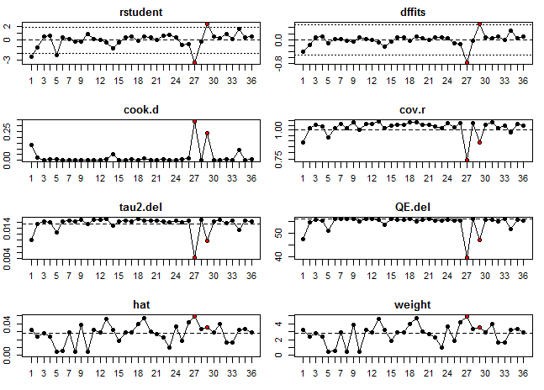
Syntax and results

Slide 16
Syntax and results
### Drop the two outliers and save the data file as BigBrain2
nrow(BigBrain) #36 observations
BigBrain2 <- BigBrain[BigBrain$ID != 28 & BigBrain$ID != 30,]
nrow(BigBrain2) #34 observations
### The outlier identifier will sometimes find additional outliers if one runs it repeatedly. We run it again on the data set BigBrain2
BigBrain2 <- escalc(measure="ZCOR", ri=r, ni=Sample_Size, data = BigBrain2)
ma.result2 <- rma(yi, vi, data=BigBrain2, level=95, method="DL")
ma.result2

Slide 17
Syntax and results
### The meta-analysis results ma.result is for the data set that contains outliers (BigBrain).
### ma.result3 has the results for the data set without outliers (BigBrain3)
### show ma.result for the data with outliers
ma.result
ma.result.in.r.metric
### show ma.result for the data without outliers
ma.result3
ma.result.in.r.metric3
### note that the mean changed from .3105 to .3291

Slide 18
Syntax and results
### First, we run publication bias analyses on the data set with outliers
Output.Title1 <- "Sensitivity analysis results"
Output.Title2 <- "BigBrain data"
Output.Title3 <- "Original data; incl. outliers"
dat <- BigBrain
names(dat)
dat$N <- dat$Sample_Size
source("V1_6_sensitivity analysis for correlations.R")
beep(2)

Slide 19
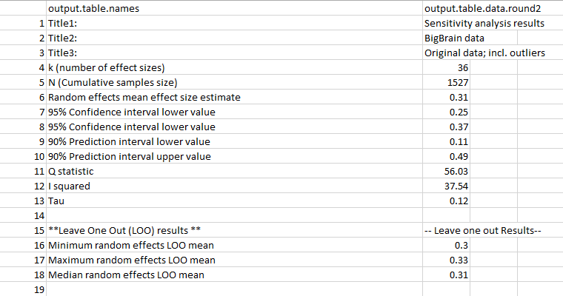
Results (original data; incl. outliers)

Slide 20
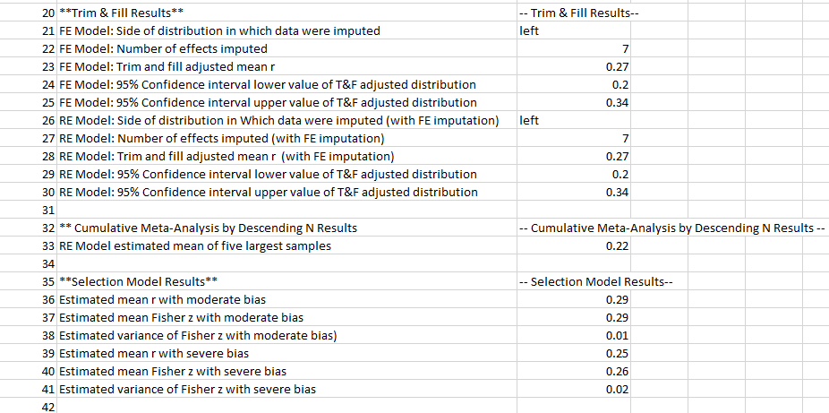
Results (original data; incl. outliers)

Slide 21
Results (original data; incl. outliers)

Slide 22
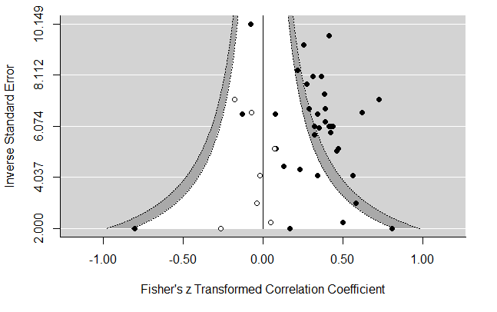
Results (original data; incl. outliers)
Contour-enhanced funnel plot:

Slide 23
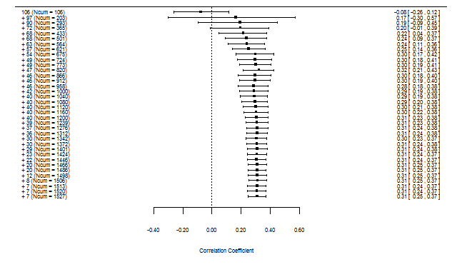
Results (original data; incl. outliers)
Cumulative meta-analysis by precision:

Slide 24
Results (data excl. outliers)
### Second, we run publication bias analyses on the data set with outliers removed
Output.Title1 <- "Sensitivity analysis results"
Output.Title2 <- "BigBrain data"
Output.Title3 <- "Data excl. outliers"
dat <- BigBrain3
names(dat)
dat$N <- dat$Sample_Size
source("V1_6_sensitivity analysis for correlations.R")
beep(2)

Slide 25
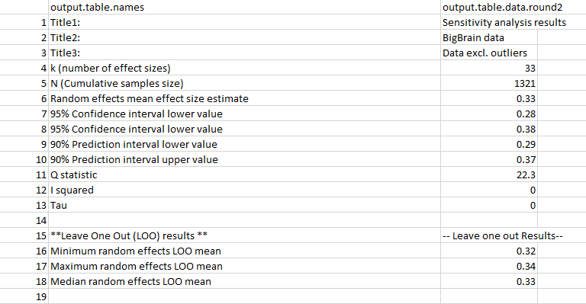
Results (data excl. outliers)

Slide 26
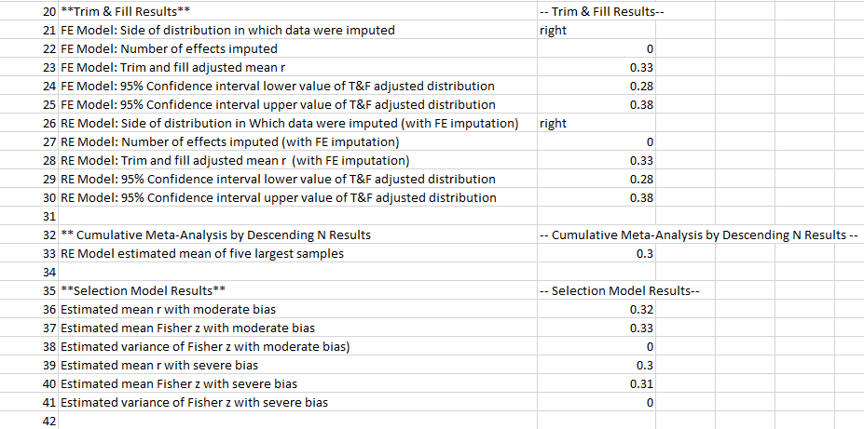
Results (data excl. outliers)

Slide 27
Results (data excl. outliers)

Slide 28
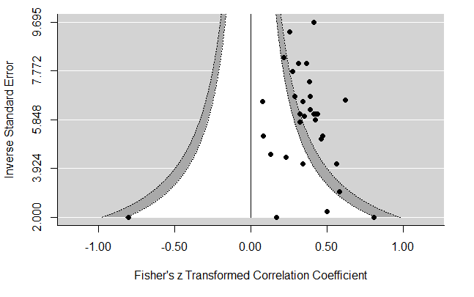
Results (data excl. outliers)
Contour-enhanced funnel plot:

Slide 29
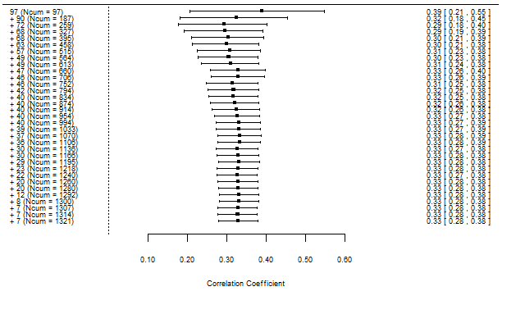
Results (data excl. outliers)
Cumulative meta-analysis by precision:

Slide 30
Results table (for your journal article)
k = number of correlation coefficients; ${\overline{r}}_{o_{RE}}$ = random-effects weighted mean observed correlation; 95% CI = 95% confidence interval; 90% PI = 90% prediction interval; Q = weighted sum of squared deviations from the mean; I² = ratio of true heterogeneity to total variation; τ = between-sample standard deviation; osr = one-sample removed, including the minimum and maximum effect size and the median weighted mean observed correlation; Trim and fill = trim and fill analysis; FPS = funnel plot side (i.e., side of the funnel plot where samples were imputed; L = left, R = right); ik = number of trim and fill samples imputed; t&f_{FE} ${\overline{r}}_{o}$ = fixed-effects trim and fill adjusted observed mean; t&f_{FE} 95% CI = fixed-effects trim and fill adjusted 95% confidence interval; t&f_{RE} ${\overline{r}}_{o}$ = random-effects trim and fill adjusted observed mean; t&f_{RE} 95% CI = random-effects trim and fill adjusted 95% confidence interval; sm_{m} ${\overline{r}}_{o}$ = one-tailed moderate selection model’s adjusted observed mean; sm_{s} ${\overline{r}}_{o}$ = one-tailed severe selection model’s adjusted observed mean; CMA = cumulative meta-analysis; pr ${\overline{r}}_{o}$ = meta-analytic mean estimate of the five most precise effects; PET-PEESE = precision-effect test-precision effect estimate with standard error; PET-PEESE ${\overline{r}}_{o}$ = PET-PEESE adjusted observed mean.

Slide 31
Thanks!
Questions?
Contact information:
Sven Kepes, Ph.D.
Associate Professor of Management
skepes@vcu.edu
Michael A. McDaniel, Ph.D.
Professor of Management
mamcdani@vcu.edu

Slide 32
References
Aguinis, H., Dalton, D. R., Bosco, F. A., Pierce, C. A., & Dalton, C. M. (2011). Meta-analytic choices and judgment calls: Implications for theory building and testing, obtained effect sizes, and scholarly impact. Journal of Management, 37, 5-38. doi: 10.1177/0149206310377113
Banks, G. C., Kepes, S., & McDaniel, M. A. (2012). Publication bias: A call for improved meta-analytic practice in the organizational sciences. International Journal of Selection and Assessment, 20, 182-196. doi: 10.1111/j.1468-2389.2012.00591.x
Borenstein, M., Hedges, L. V., Higgins, J. P., & Rothstein, H. R. (2009). Introduction to meta-analysis. West Sussex, UK: Wiley.
Duval, S. J. (2005). The “trim and fill” method. In H. R. Rothstein, A. J. Sutton & M. Borenstein (Eds.), Publication bias in meta-analysis: Prevention, assessment, and adjustments (pp. 127-144). West Sussex, UK: Wiley.
Ferguson, C. J., & Brannick, M. T. (2012). Publication bias in psychological science: Prevalence, methods for identifying and controlling, and implications for the use of meta-analyses. Psychological Methods, 17, 120-128. doi: 10.1037/a0024445
Francis, G. (2014). The frequency of excess success for articles in Psychological Science. Psychonomic Bulletin & Review, 21, 1180-1187. doi: 10.3758/s13423-014-0601-x
Greenhouse, J. B., & Iyengar, S. (2009). Sensitivity analysis and diagnostics. In H. Cooper, L. V. Hedges & J. C. Valentine (Eds.), The handbook of research synthesis and meta-analysis (2nd ed.). (pp. 417-433). New York, NY: Russell Sage Foundation.
Grubbs, F. E. (1969). Procedures for detecting outlying observations in samples. Technometrics, 11, 1-21. doi: 10.1080/00401706.1969.10490657
Ioannidis, J. P., & Trikalinos, T. A. (2007). An exploratory test for an excess of significant findings. Clinical Trials, 4, 245-253. doi: 10.1177/1740774507079441

Slide 33
References
Kepes, S., Banks, G., C., McDaniel, M. A., & Whetzel, D. L. (2012). Publication bias in the organizational sciences. Organizational Research Methods, 15, 624-662. doi: 10.1177/1094428112452760
Kepes, S., McDaniel, M. A., Brannick, M. T., & Banks, G. C. (2013). Meta-analytic reviews in the organizational sciences: Two meta-analytic schools on the way to MARS (the Meta-analytic Reporting Standards). Journal of Business and Psychology, 28, 123-143. doi: 10.1007/s10869-013-9300-2
Peters, J. L., Sutton, A. J., Jones, D. R., Abrams, K. R., & Rushton, L. (2008). Contour-enhanced meta-analysis funnel plots help distinguish publication bias from other causes of asymmetry. Journal of Clinical Epidemiology, 61, 991-996. doi: 10.1016/j.jclinepi.2007.11.010
Stanley, T. D., & Doucouliagos, H. (2014). Meta-regression approximations to reduce publication selection bias. Research Synthesis Methods, 5, 60-78. doi: 10.1002/jrsm.1095
Vevea, J. L., & Woods, C. M. (2005). Publication bias in research synthesis: Sensitivity analysis using a priori weight functions. Psychological Methods, 10, 428-443. doi: 10.1037/1082-989X.10.4.428
Viechtbauer, W. (2015). Meta-analysis package for R: Package ‘metafor.’ R package version 1.9-5
Viechtbauer, W., & Cheung, M. W. L. (2010). Outlier and influence diagnostics for meta-analysis. Research Synthesis Methods, 1, 112-125. doi: 10.1002/jrsm.11

